Slide 1
RECORD

Slide 2
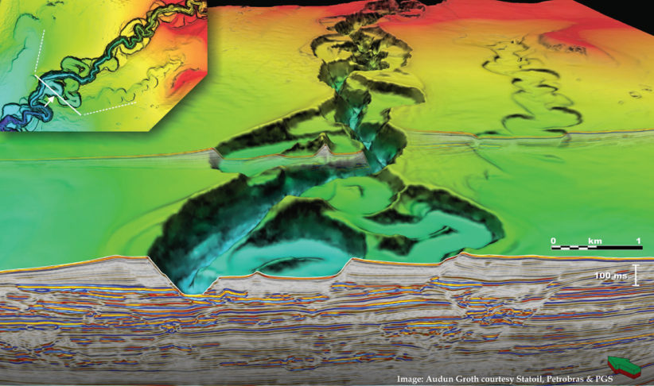
Deep-water Deep-water Sedimentary Systems 1
Part 1: Sedimentology – Process to Product
<number> -
Classification: Internal 2011-09-03

Slide 3
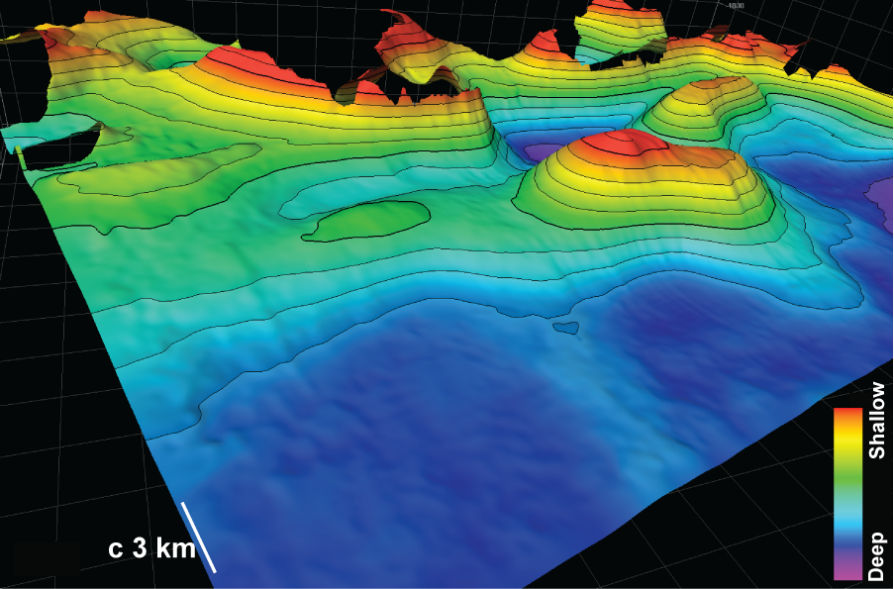
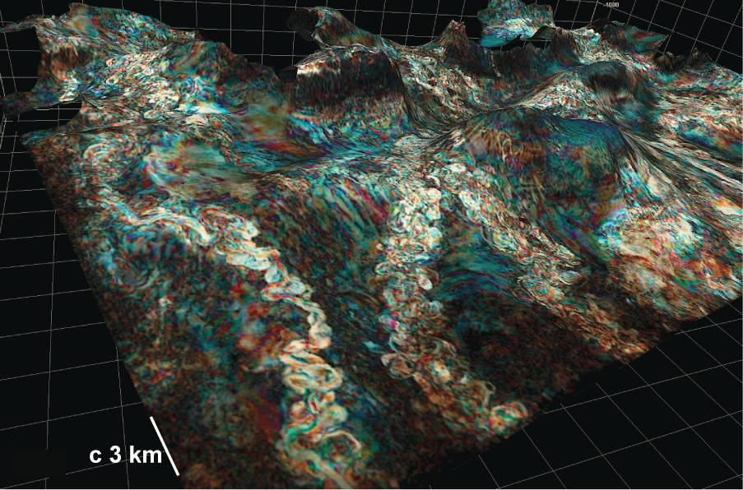
Deep-water depositional systems
Sedimentary systems lying predominantly below the storm wave base (10s – 100s metres).
Topographically low – gravity wants to move particles there.
Difficult for particles to get out once they are there.
Therefore – deep-water depositional systems form the ultimate resting place for much of the worlds sediment, organic matter, and increasingly pollutants.
Submarine channels around salt topography offshore Angola
Notes:
Sediment gravity flows entering deep marine or lacustrine basins may be confined, unconfined, or a combination of the two. Typically, through time, flows with sufficient energy will develop some degree of confinement, either through degradation of the slope profile, or through aggradation, i.e., levee development. The dynamic equilibrium profile of the slope will dictate the behaviour of the channel profile along its length (e.g., Pirmez et al., 2000; Kneller, 2003). Channels which are considered to be ‘at grade’, neither incise, nor aggrade, and are largely constrained to migrate laterally across the slope (Kneller, 2003). The interaction of sediment gravity flows with the slope over which they flow therefore has significant implications for the resultant large scale architecture of sand-bodies.
Local topography may also exert a strong control on flows, confining flows in some cases, dictating the course of channelised flows in others (e.g. Rowan & Weimer, 1998; Weimer et al., 1998; Mayall et al., 2006; Nelson et al., 1999; Pirmez et al., 2000; Prather, 2000;). Topography generated by gravity tectonics is particularly important in many areas, such as the Gulf of Mexico (Rowan & Weimer, 1998; Gee & Gawthorpe, 2006), slump induced topography may be influential in some areas (Cronin et al., 1998), whilst folding and faulting, both in the form of pre-exisiting and syn-depositionally active features, are important in others (e.g., Soreghan et al., 1999; Broucke et al., 2004; Mayall et al., 2006).

Slide 4
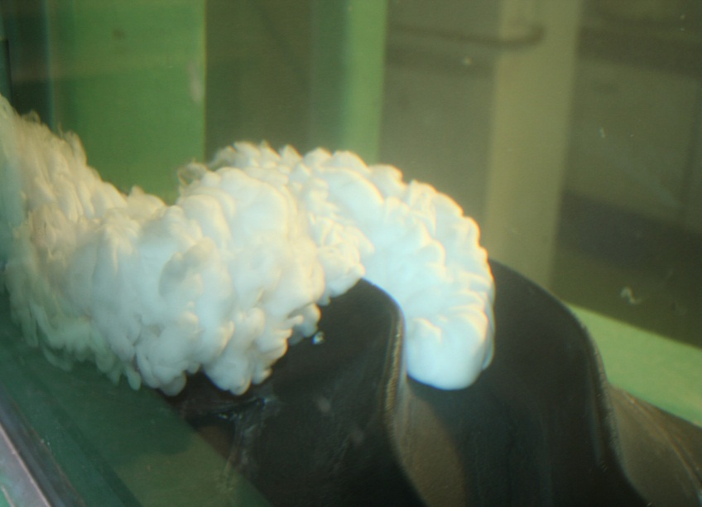
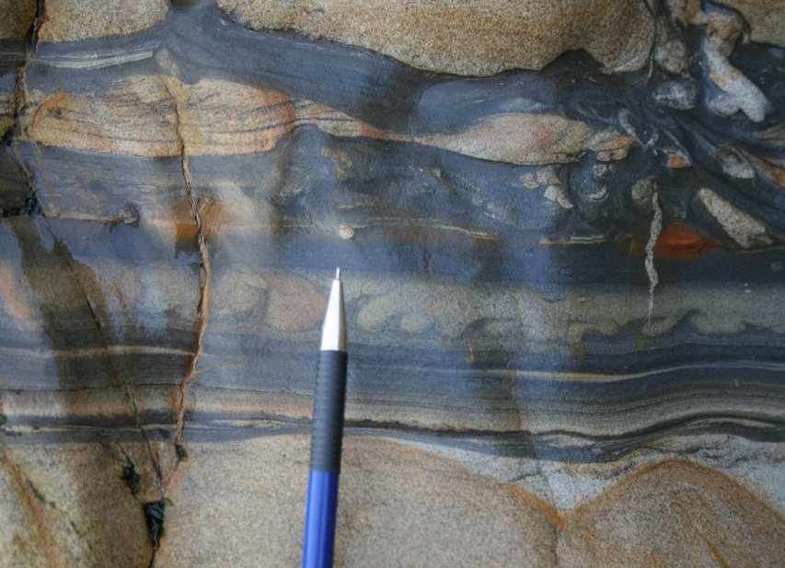
Contents
Physical Processes in Deep Water Settings
  Process to product
  Beds
  Depositional elements
  Depositional systems
  The stratigraphic record
Deep-Water Facies and Core Expression

Slide 5
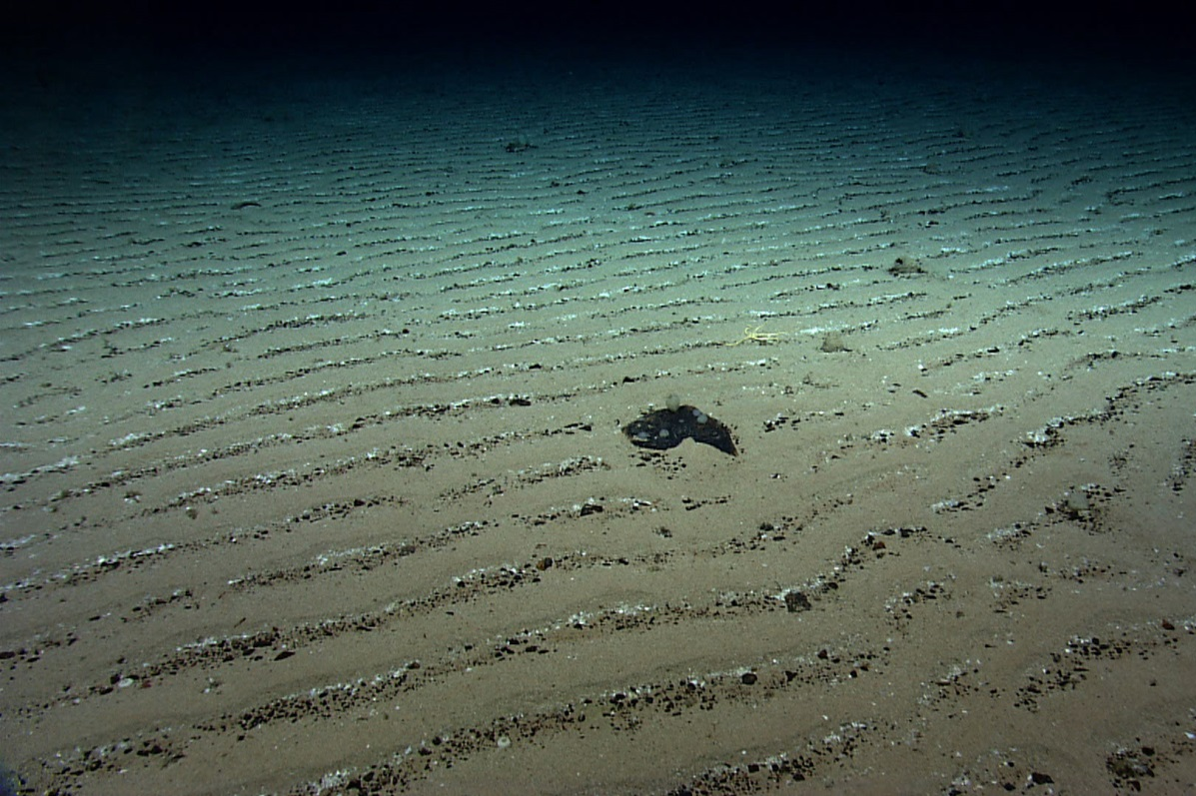
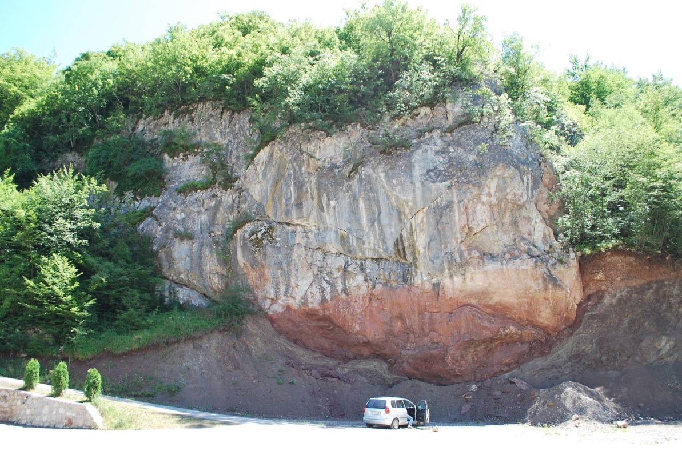
Deep-Water sediments
Range in size from micron-scale pelagic suspension deposits, to megaclasts and km-scale submarine landslides
We will concentrate on siliciclastic sediment transport and depositional processes
Will also discuss post-depositioanl deformational processes such as slumping, sliding and sand injection
Notes:
Muddy seafloor: https://www.science.org.au/curious/earth-environment/sediments
Olistostrome: https://en.wikipedia.org/wiki/Olistostrome#/media/File:Olistolite_Western_Serbia.JPG

Slide 6


<number> -
Classification: Internal 2011-09-03
Natural Resources Canada.
Notes:
The aftermath of the 1929 Grand Banks Earthquake. This image shows The home of Steven Henry Isaacs of Port au Bras, which was towed back to shore after being swept out to sea by the tsunami and anchored to the fishing schooner Marian Belle Wolfe.

Slide 7
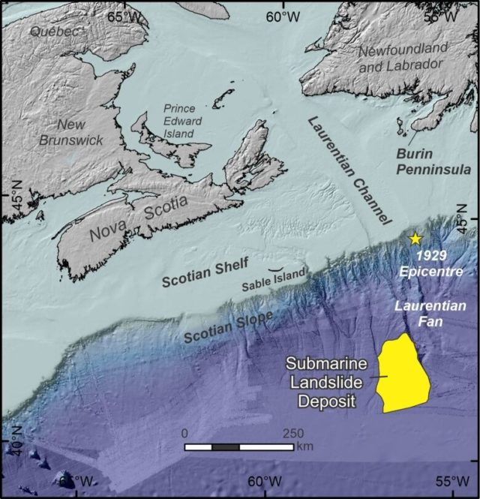
Grand Banks Earthquake 1929
The facts:
Upper continental slope
Mw 7.2
Associated with strike slip fault at c. 20km
Caused submarine landsliding that broke seafloor cables
Landslides estimated to have moved at 50 m s⁻¹
Turbidity current velocity estimate: 15-30 m s⁻¹
First direct evidence of turbidity currents in the wild
Notes:
Alexandre Normandeau, D. Calvin Campbell, David J.W. Piper and Kimberley A. Jenner. 2019. Are submarine landslides an underestimated hazard on the western North Atlantic passive margin?. Geology 47 (9): 848–852. doi: https://doi.org/10.1130/G46201.1

Slide 8
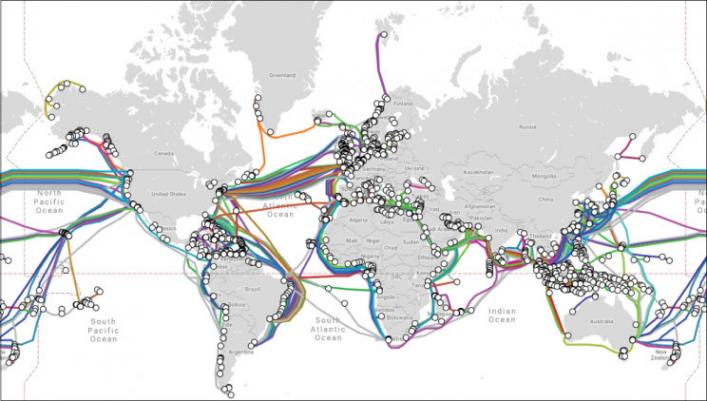
Who cares?
Notes:
https://theconversation.com/in-our-wi-fi-world-the-internet-still-depends-on-undersea-cables-49936

Slide 9
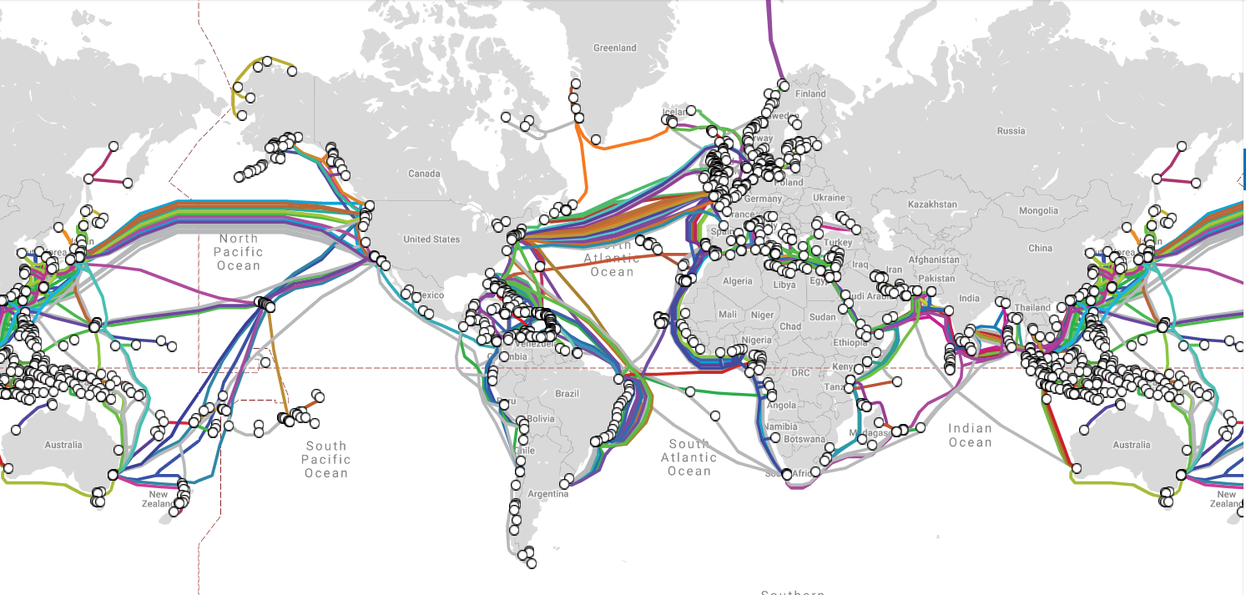
Critical global communication links
Carries >99% of all digital data traffic
The world is connected by more than
350
>1.8 million
kilometres of cable installed
enough cable to
circle the Earth
25 times
SUBMARINE CABLE SYSTEMS
<number> -
Classification: Internal 2011-09-03
www.iscpc.com

Slide 10
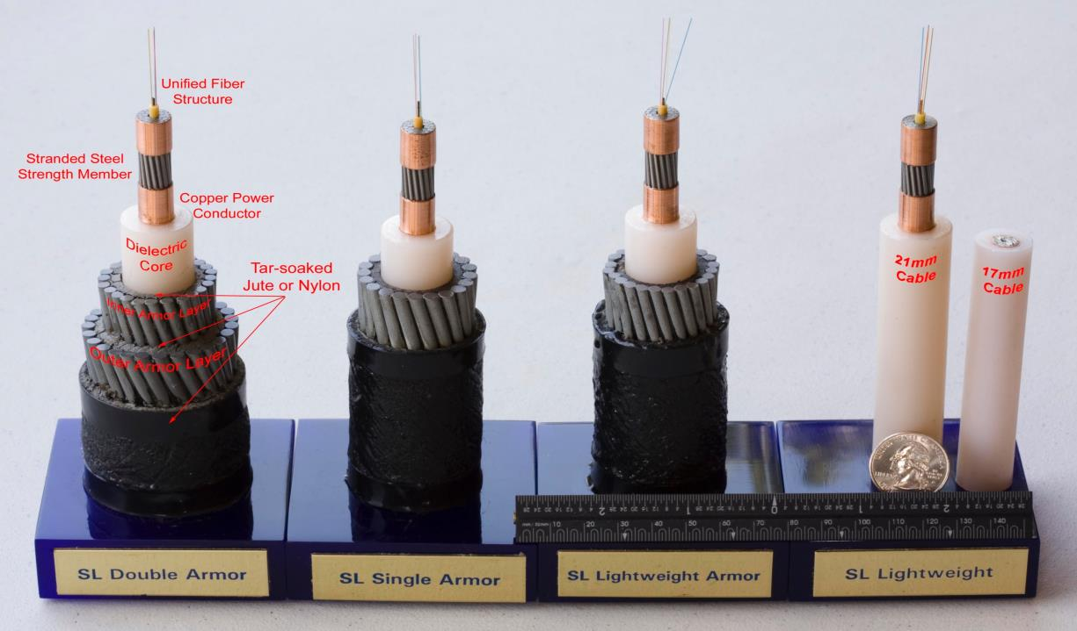
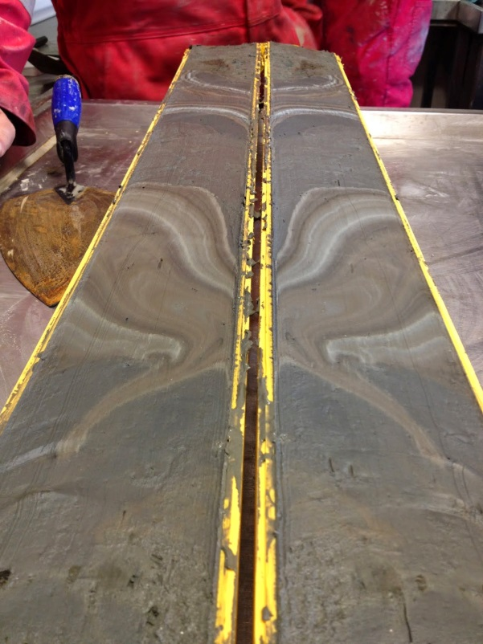
To protect these:
We need to understand these:
www.iscpc.com
Image courtesy of Millie Watts, BOSCORF, National Oceanography Centre Southampton.

Slide 11
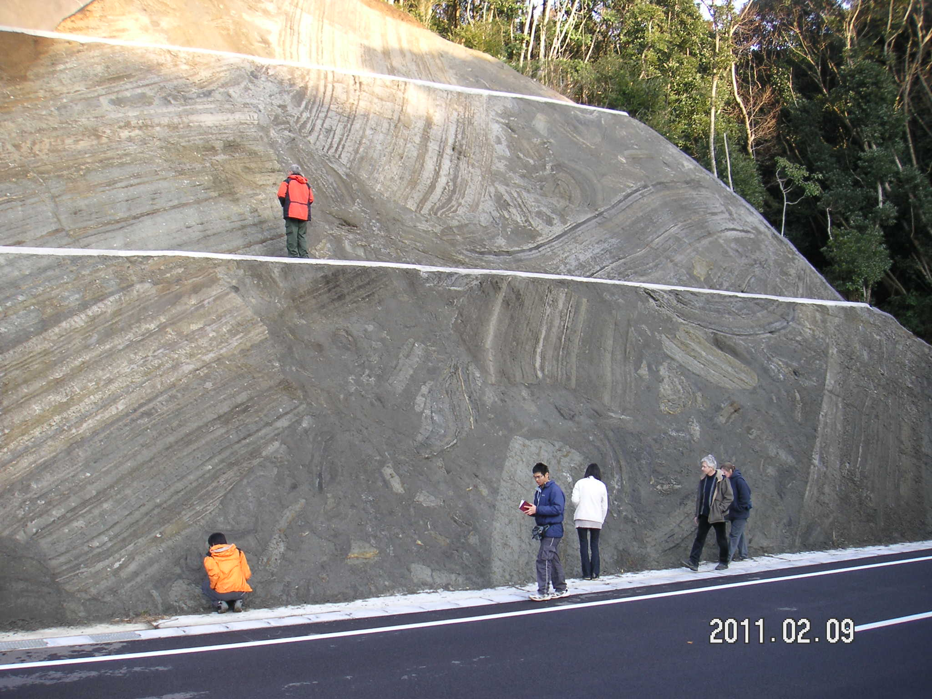

Boso Peninsula, Japan

Slide 12
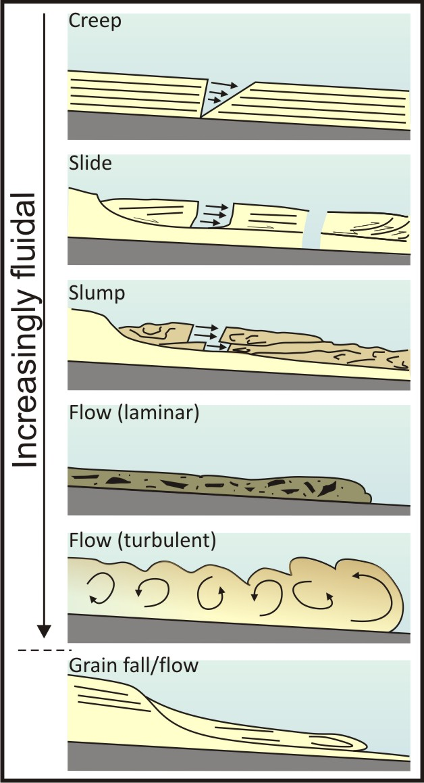
Physical processes of sediment transport in deep water
Six classes ranging from creep of consolidated material to fall of completely unconsolidated sediment
Increasing mobility of material and grain freedom from creep to fall
Sediment gravity flows are most important for moving coarse sediment to deep water environments
  Fluidal flows (turbidity currents)
  Laminar flows (debris flows)

Slide 13
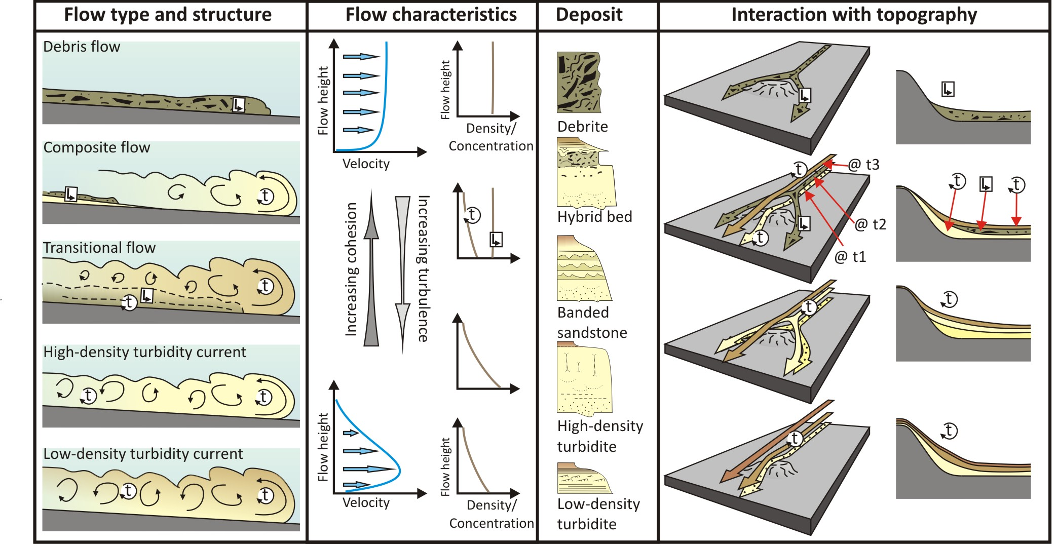
Sediment Gravity Flows

Slide 14
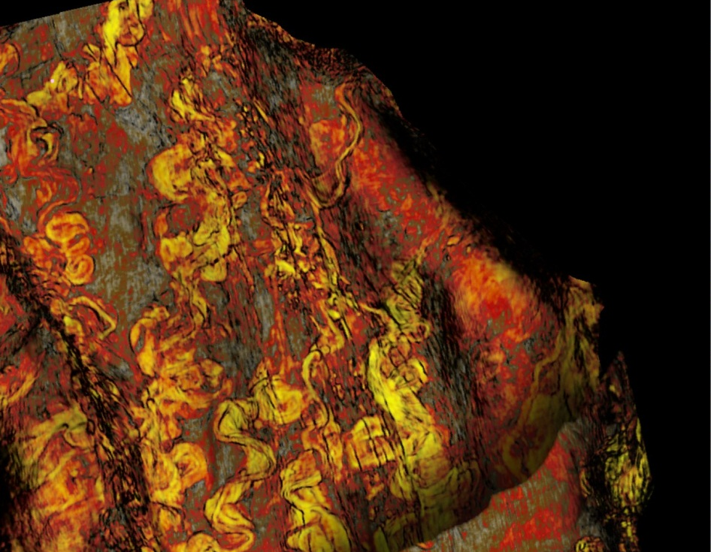
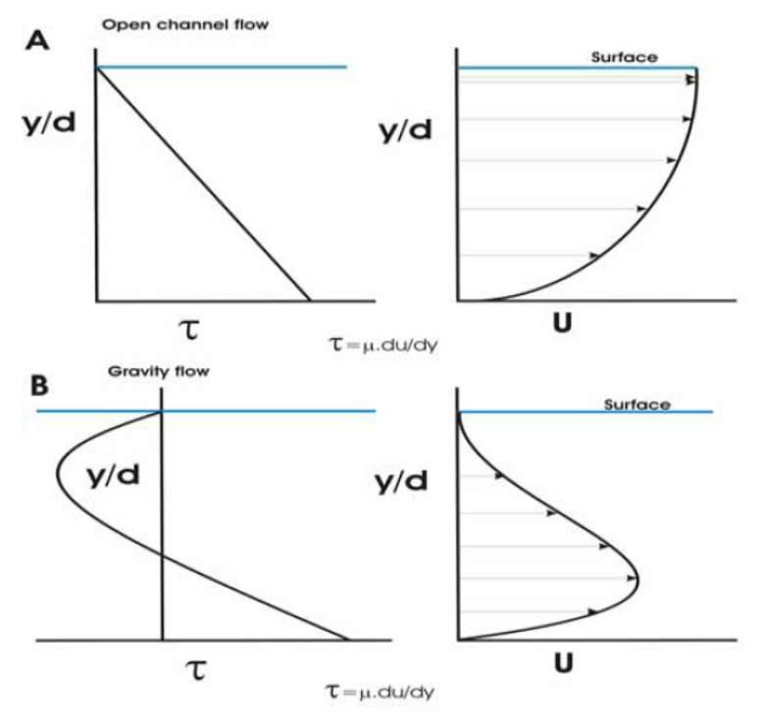
Turbidity Currents
Definition: A turbidity current is a flow driven by the action of gravity upon the density excess of a sediment laden fluid within an ambient fluid. Sediment is maintained in suspension by the upwards (and chaotically) directed turbulent flow cells.
Flows have a dominantly Newtonian rheology
In the absence of turbulence, particles will settle from suspension
In the absence of sediment, the flow will stop (unlike a river)
Deposit character is directly linked to the rate of deposition, which, in turn is linked to the steadiness of the flow.
The deposits of turbidity currents are termed Turbidites.

Slide 15
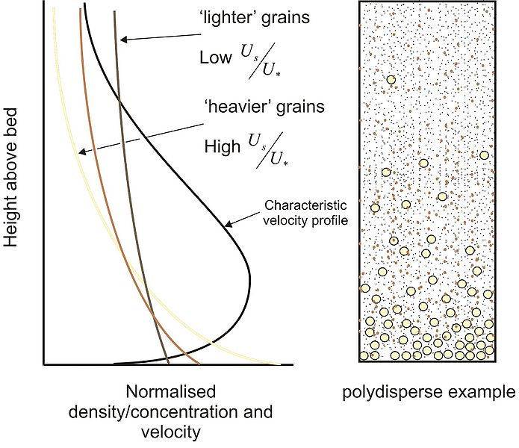
Particle suspension
A typical low concentration turbidity current
Notes:
Us = settling velocity, U* = shear velocity

Slide 16
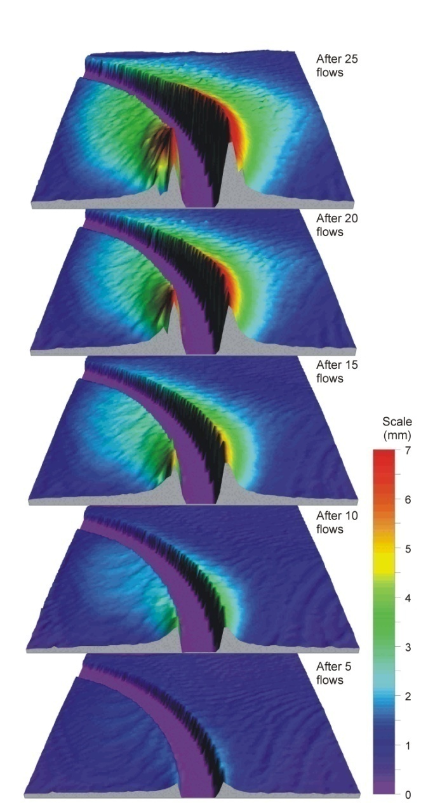
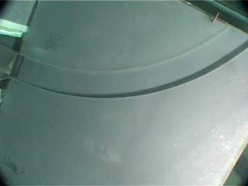
Channelised turbidity current
Kane et al. 2008; 2010
Notes:
Kane I. A., McCaffrey W. D., Peakall, J. 2008. Controls on Sinuosity Evolution within Submarine Channels. Geology, 36, 287-290.
Kane, I.A., McCaffrey, W.D., Peakall, J. and Kneller, B.C. 2010. Submarine channel levee shape and sediment waves from physical experiments. Sedimentary Geology, 223, 75-85.

Slide 17
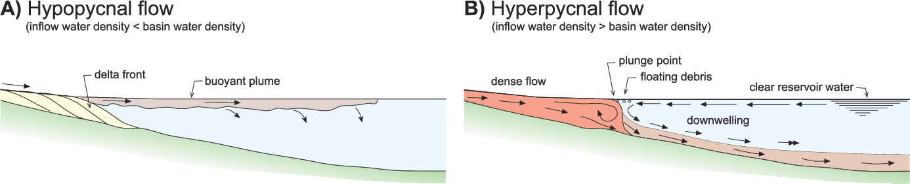
Turbidity current initiation
Submarine landslides (delta collapse, canyon collapse) triggered by earthquakes or over-steepening
Homopycnal and hyperpycnal flow: https://www.youtube.com/watch?v=_nQmixV5fNs
Zavala et al. 2011
Notes:
https://www.semanticscholar.org/paper/A-Genetic-Facies-Tract-for-the-Analysis-of-Flow-Zavala-Arcuri/52796537dbbd2f0002fa8ee017cbcf49b0bc6010/figure/0

Slide 18
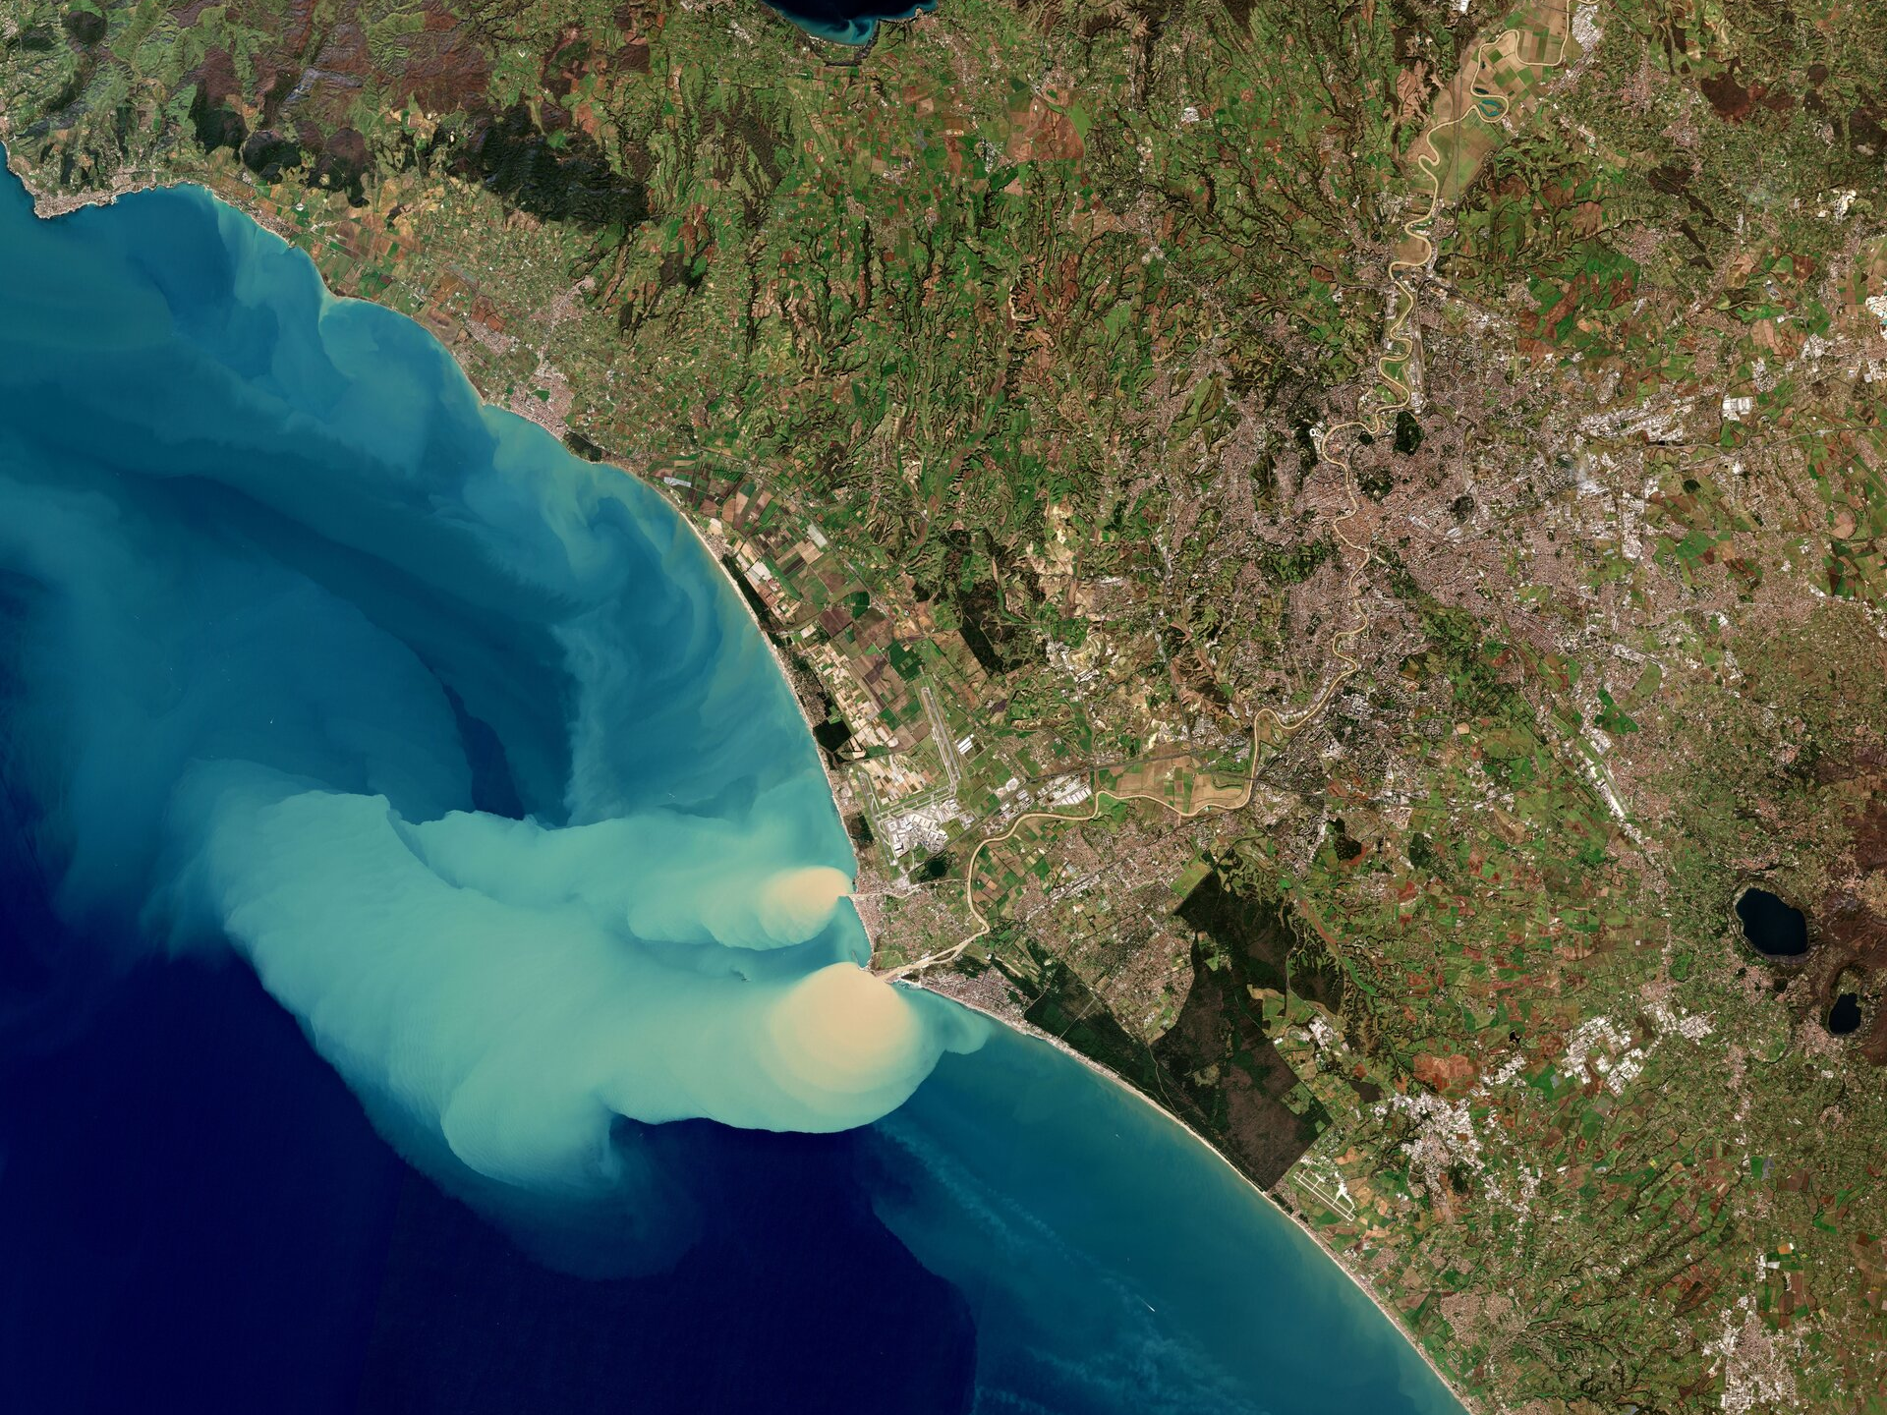
<number> -
Classification: Internal 2011-09-03
Notes:
The Tiber River can be seen snaking its way southwards in the image. The third longest river in Italy, it rises in the Apennine Mountains and flows around 400 km before flowing through the city of Rome and draining into the sea near the town of Ostia. The Tiber River plays an important role in sediment transport, so coastal waters here are often discoloured. However, the recent rains resulted in a large amount of sediment pouring into the Tyrrhenian Sea, as this image shows. The sediment plume can be seen stretching 28 km from the coast, carried northwest by currents. https://www.esa.int/ESA_Multimedia/Images/2019/02/Sediment_plume_at_seahyperpycnal flow red sea

Slide 19

<number> -
Classification: Internal 2011-09-03

Slide 20
Gravity flow deposits
Turbidity current: turbidite. Turbidites don’t flow!
Debris flow: debrite
Hyperpycnal flow: hyperpycnite
Pelagic sediment: pelagite
Hemipelagic sediment: hemipelagite
Channel: channel fill etc.
Process and product should not be used interchangeably
<number> -
Classification: Internal 2011-09-03

Slide 21

Low-density turbidites (LDT) / the Bouma Sequence
Pelagic interval:
Clayey marl (mixture of clay and calcium carbonate) Results from accumulation of floating organisms such as foraminifers.
Te
Pelitic interval:
Clayey sediments with no distinct sedimentary structures. Sand content decreases upward.
Td
Upper interval of parallel lamination:
Parallel lamination in very fine sand and silty clay generated during lower stage flow regime current conditions.
Interval of current ripple- and deformed convolute-lamination:
Small-scale current ripples (<5cm high) in fine grained sand & silt. Deformation caused by escaping water and sediment.
Tc
Lower interval of parallel lamination:
Thick parallel lamination in (occasionally graded) sand generated during upper stage flow regime current conditions.
Tb
Ta
Graded/massive interval:
Upward fining in grain-size caused by gradual decline in current velocity. No apparent sedimentary structures.

Slide 22
High-density turbidites (HDT)
Bouma Ta
Traction structures
Graded/massive interval:
Upward fining in grain-size caused by gradual decline in current velocity. No apparent sedimentary structures.
Tt
Suspension-sedimentation stage
S3
Traction-carpet stage
S2
Suspension-sedimentation stage
Traction sedimentation stage
M
R3
S1
Normally graded gravel layer
Traction-carpet stage
Traction structures: Medium- and fine-grained sandstones with
deformed flat lamination and large-scale cross-stratification.
R2
Tt
Inversely graded gravel layer
Traction sedimentation stage
S3
Suspension-sedimentation stage: Massive with or without water
escape structures such as dish and pillars
R1
Coarse gravel showing traction structures
S2
Traction-carpet stage: Inversely graded coarse-grained sand and
granule layers. Individual layers are 5-15 cm thick.
S1
Traction sedimentation stage: “Proximal”, pebbly sandstones.
Plane beds, flat and oblique lamination and cross stratification.
Locally erosive.

Slide 23
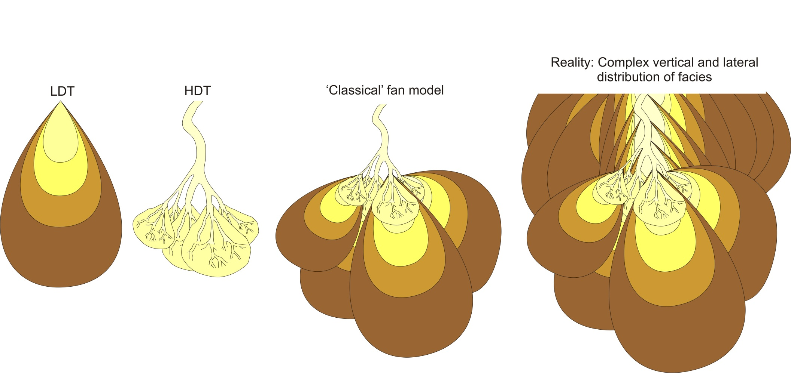
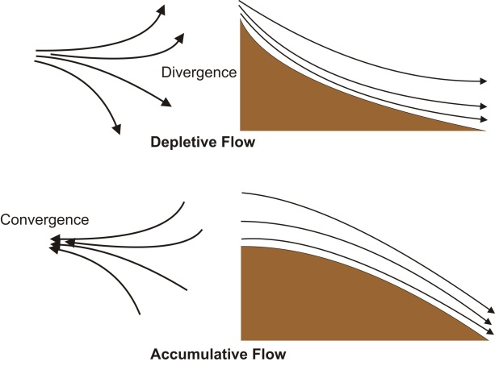
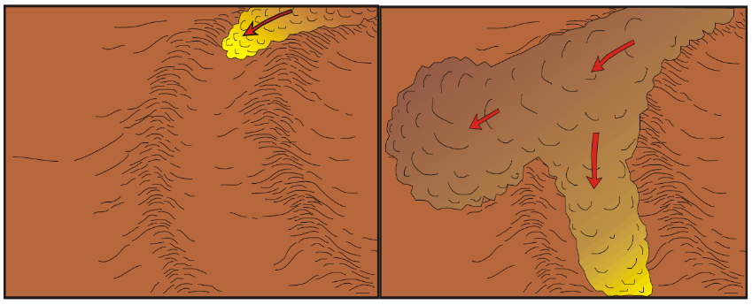
Distribution of high- & low-density turbidites
Proximal to distal
Axial to Marginal
LDT
HDT
Modified after Kneller (1995)
Modified after Peakall et al. (2000)

Slide 24
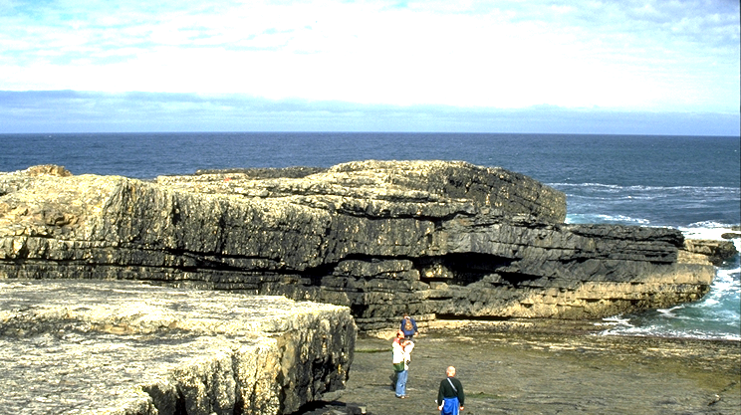
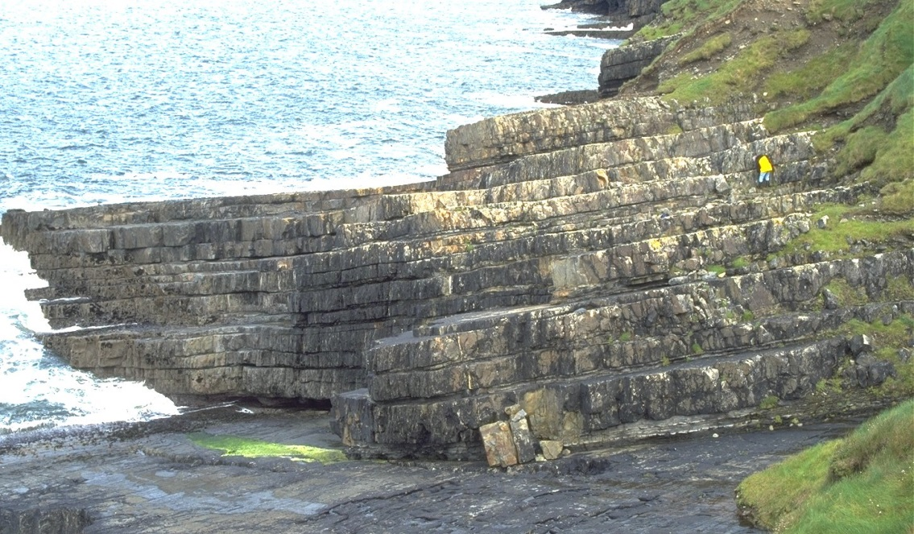
Thick-bedded turbidites
Within or outside channel deposition?
Evidence of channel deposition?
  Bed amalgamation
  Clasts
    Intraformational mudflakes
    Extraformational grains
  Mix of facies
    Thin- and thick-bedded turbidites
    Bypass-parts of deposits
    Debris flow deposits
    Coarser grains than outside channels

Slide 25
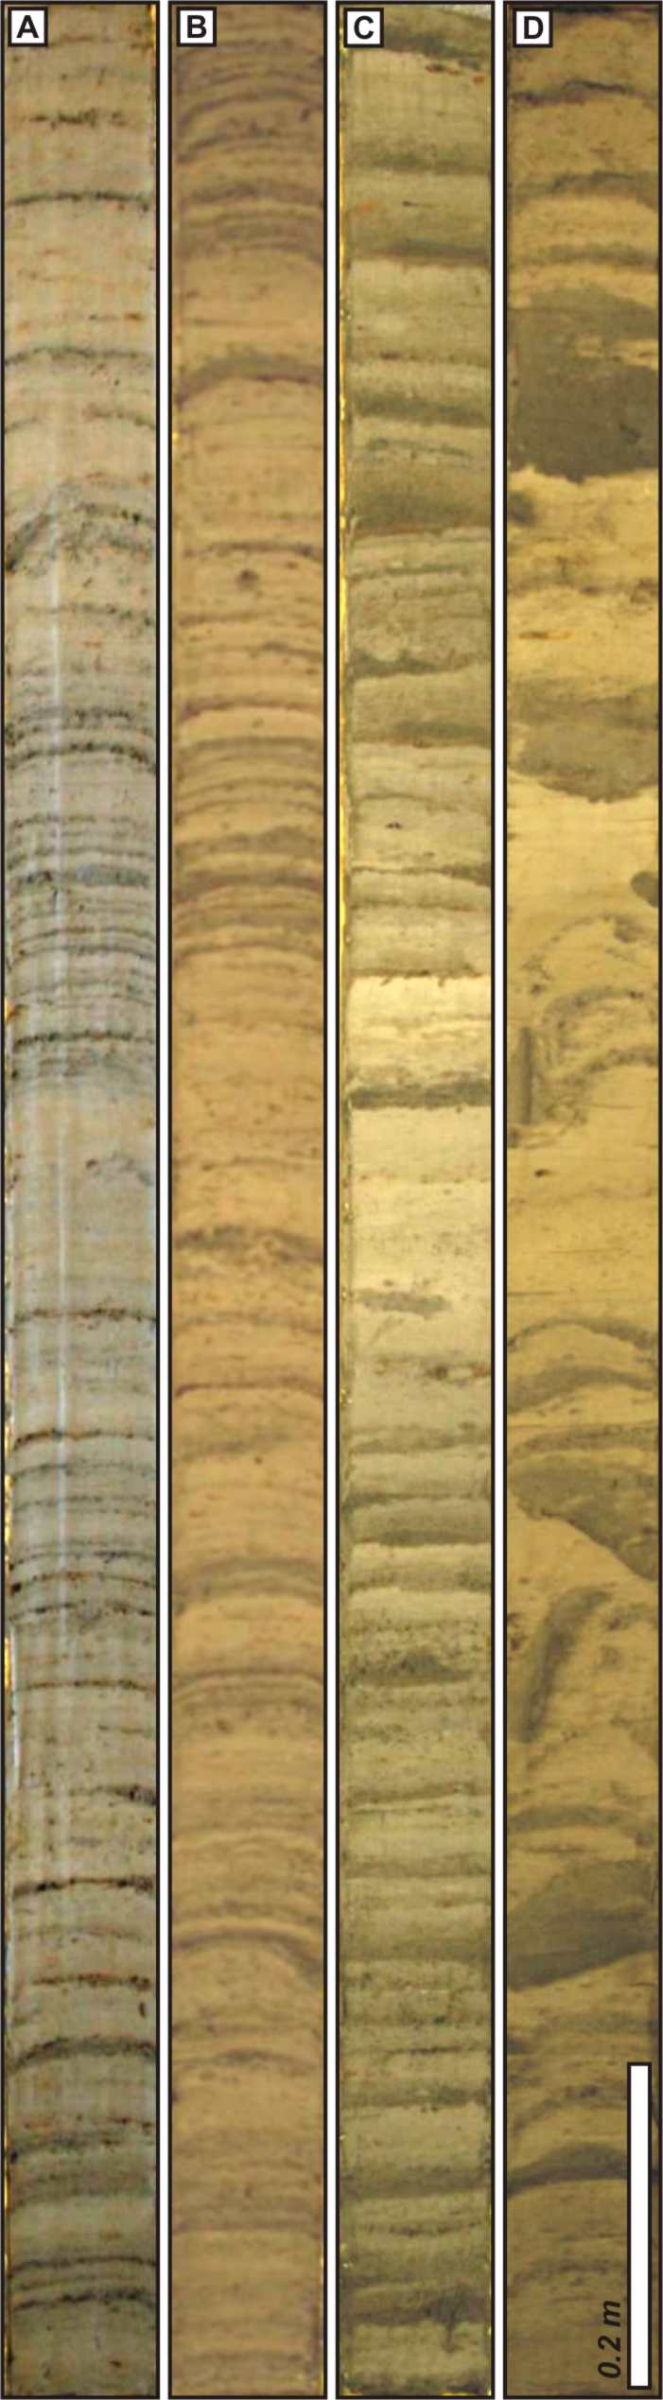
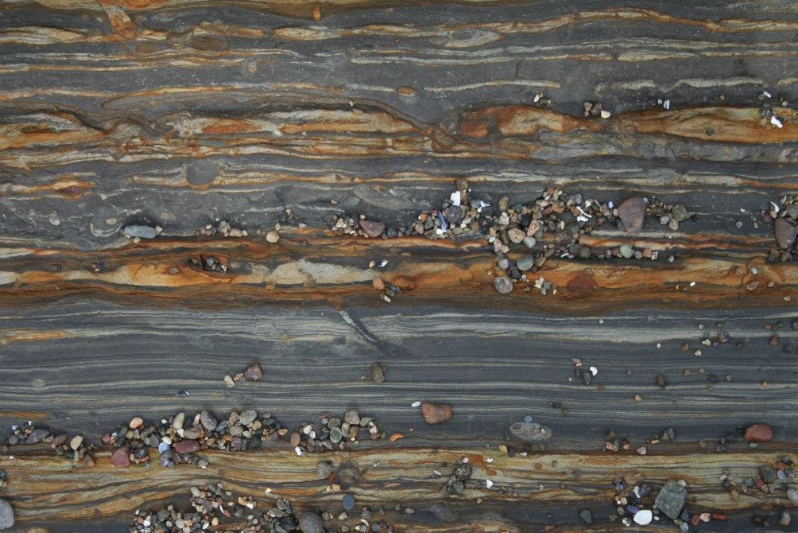
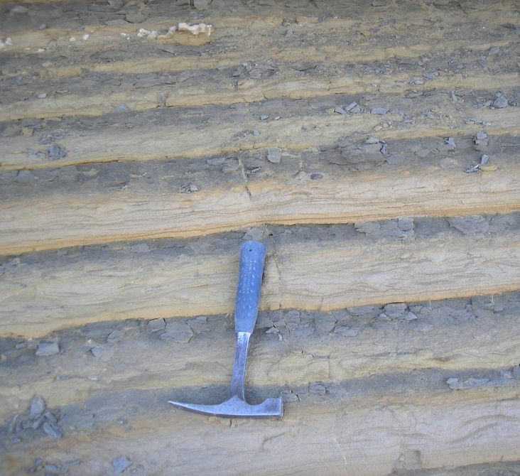
Turbidites – thin-bedded
Levee (internal or external) or basin plain turbidites - or no genetic context at all??
External levee sands generally classical turbidites which thin upwards
  Dominance of climbing ripples
  Lack of erosional structures
  Laterally continuous from channel to pinch out
Internal levees = multiple ripple sets, palaeocurrent complexity, poorly organized
Basin floor turbidites will be dominated single ripple form sets

Slide 26
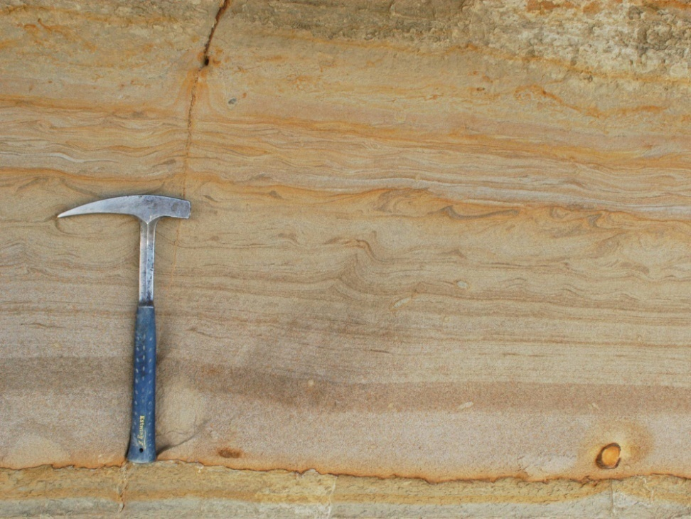
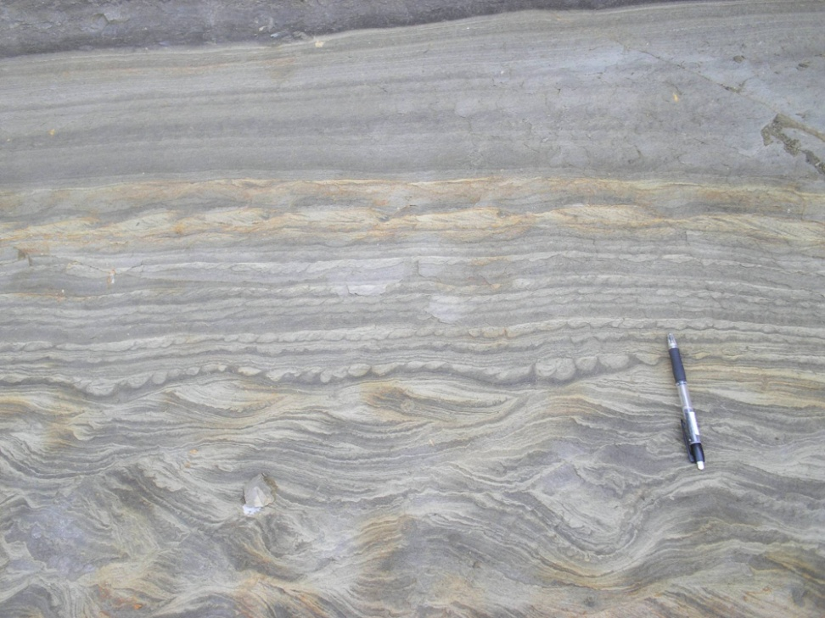
Thin-bedded turbidites
From this….. To this!
Understanding genesis is important!

Slide 27
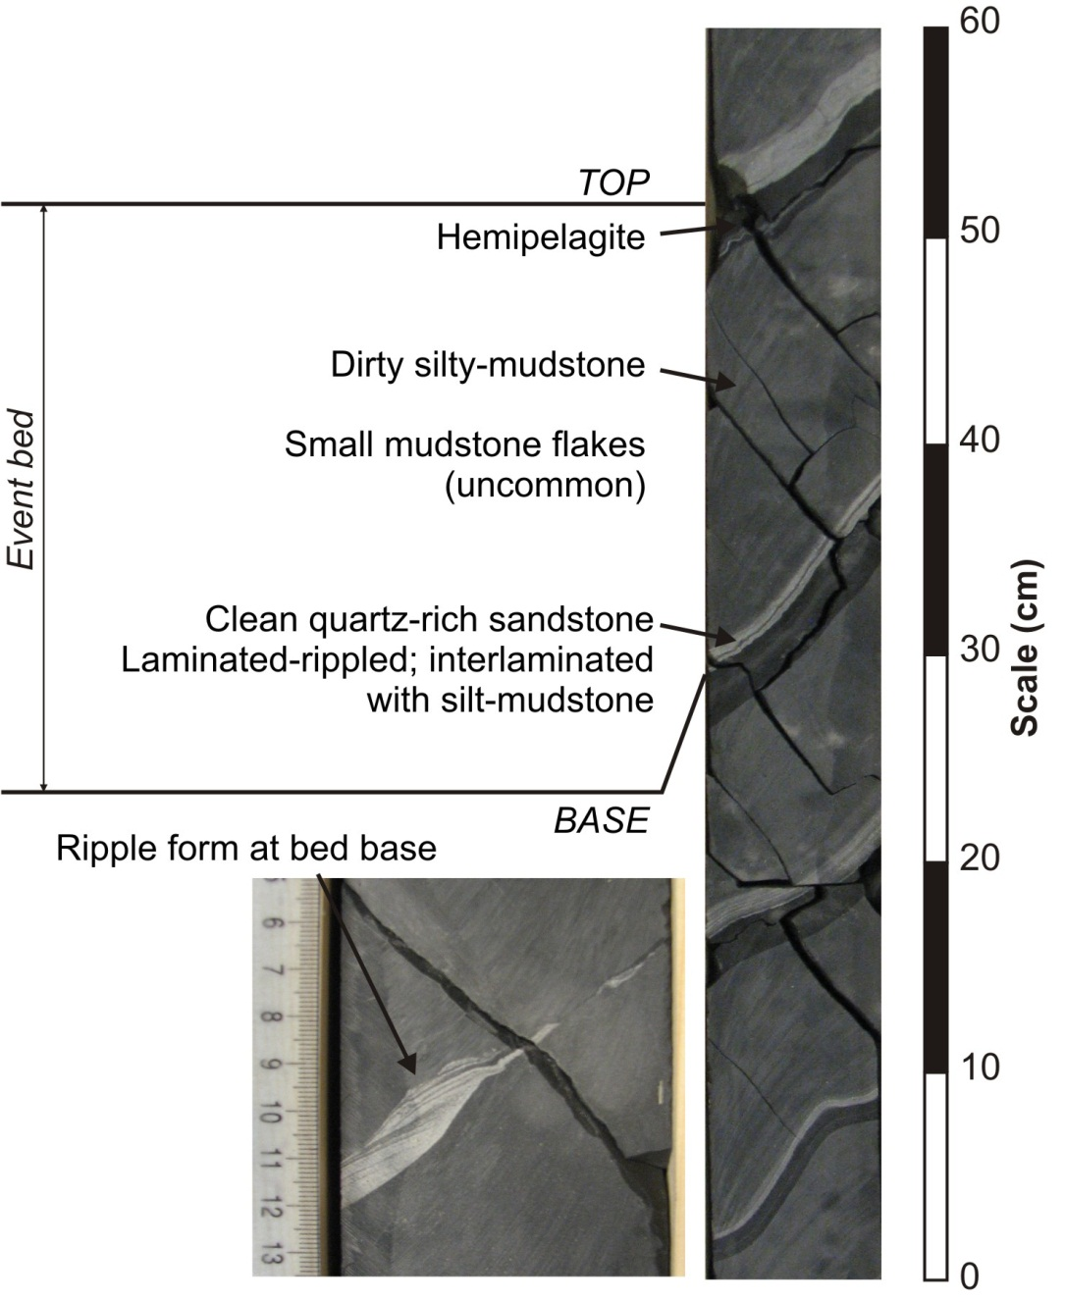
Clare core example
Very thin sands
Clean
Thick mud-caps
Regular thickness distribution
Flow processes?
Environment of deposition?

Slide 28
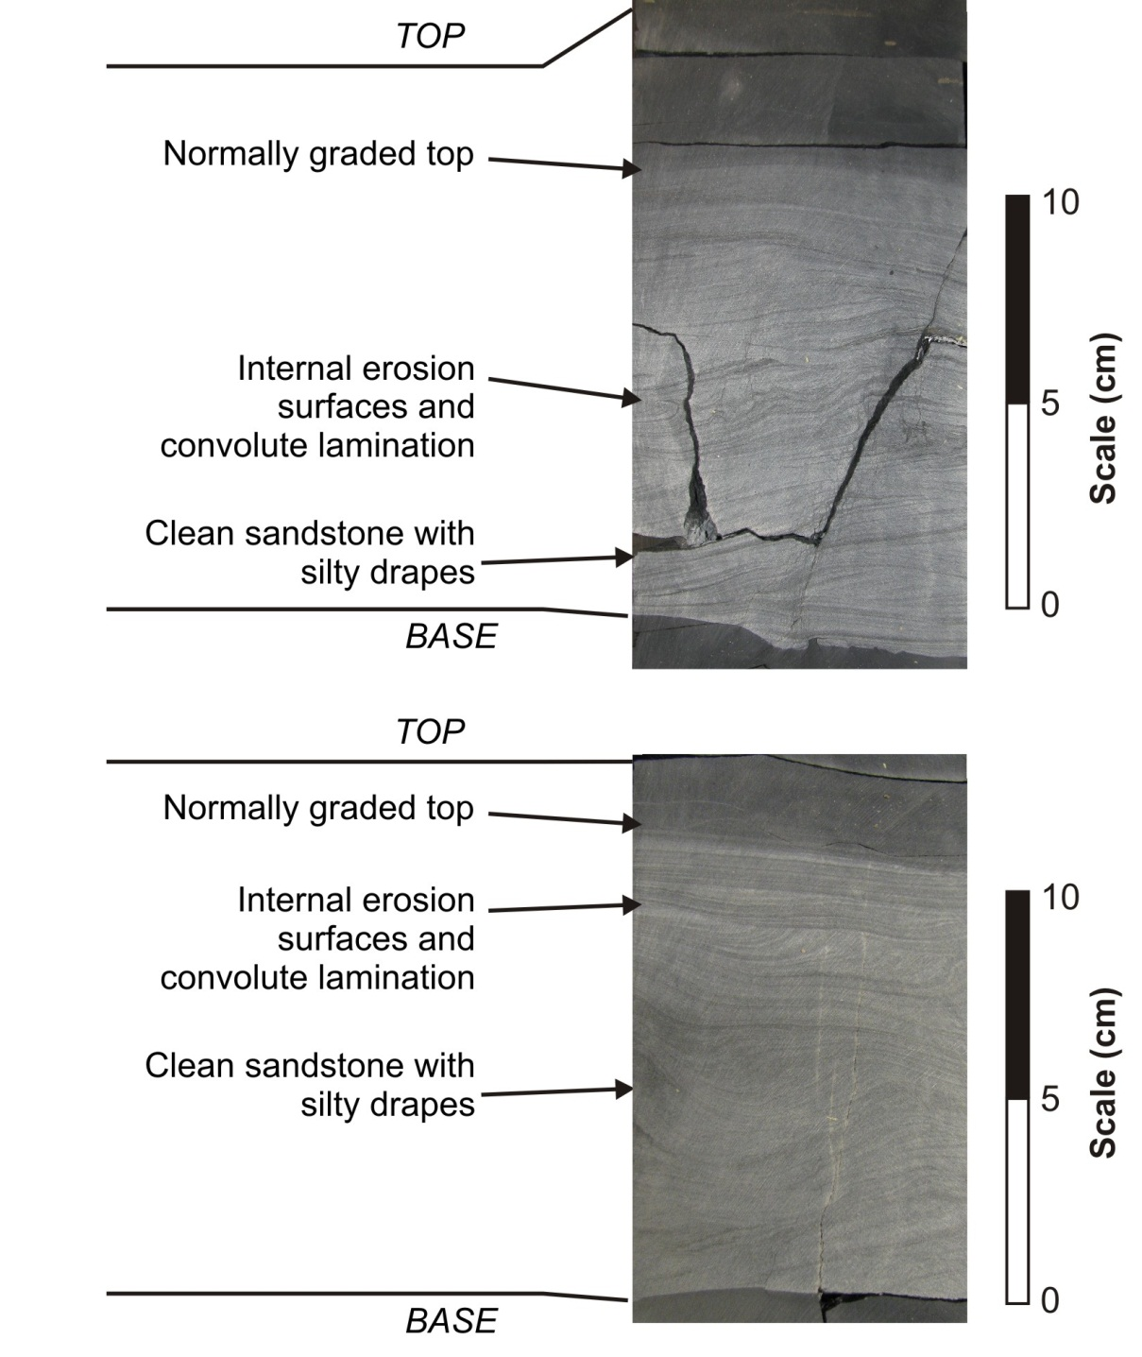
Clare core example
Thicker, traction dominated sands
Clean but draped sands
Flow processes?
Environment of deposition?

Slide 29
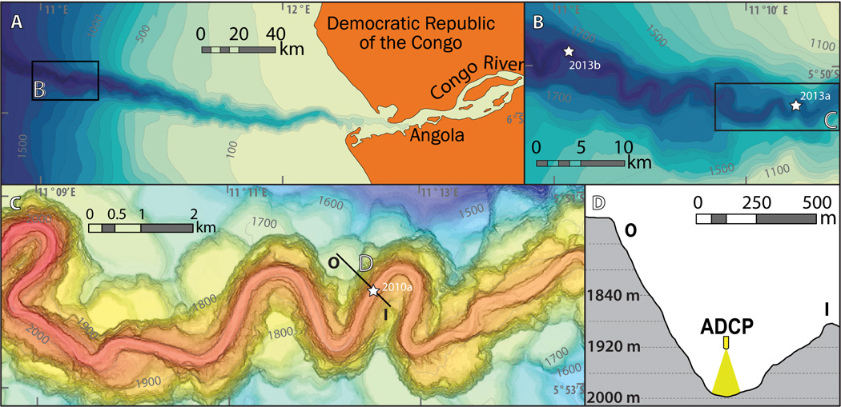
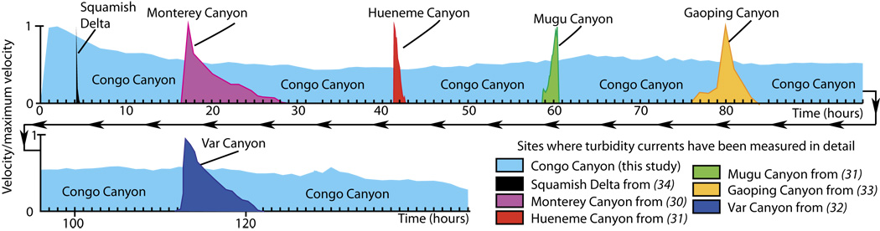
Congo Canyon – Azpiroz-Zabala et al. 2017
<number> -
Classification: Internal 2011-09-03
Notes:
A major surprise from both the 2009–2010 and 2013 measurements was that individual turbidity currents lasted for almost a week (Fig. 2 and Table 1), rather than hours or minutes as in all previous oceanic measurements from shallower water (Fig. 2). https://advances.sciencemag.org/content/3/10/e1700200

Slide 30
‘hybrid beds’

Slide 31
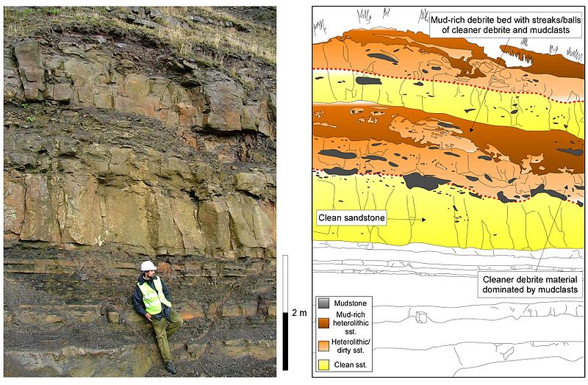
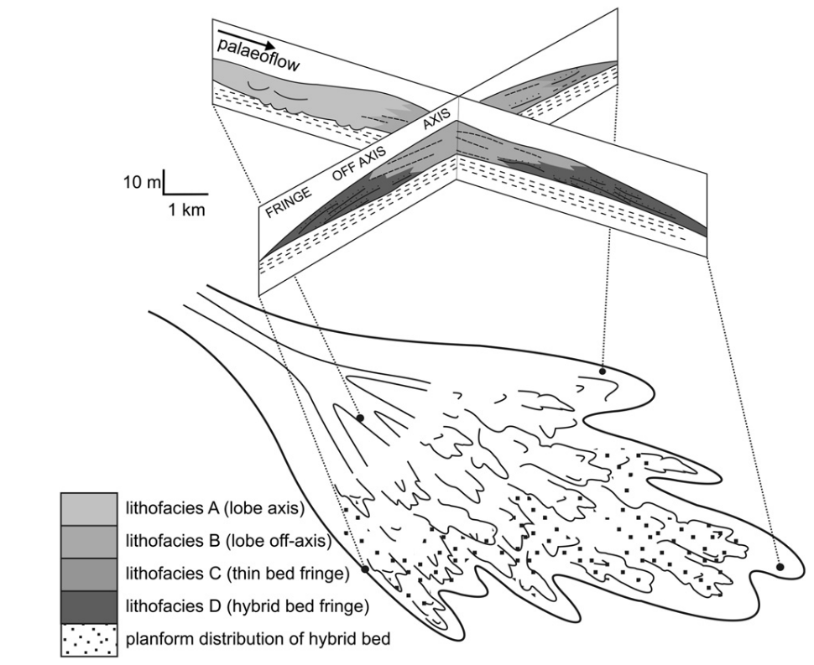
Hybrid Event Beds
Basin floor hybrid events beds (Skoorsteenberg Formation, Tanqua depocentre, Karoo Basin) (Hodgson, 2009).
Basin floor hybrid events beds (Mam Tor Sandstone, Carboniferous, UK). Image from Chris Davis (TRG).
Often well developed in off-axis and distal positions

Slide 32
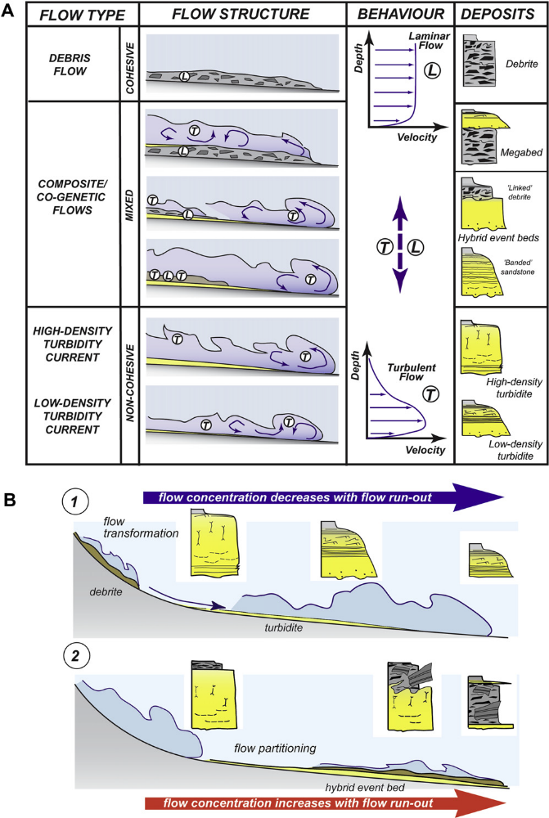
1: turbidity current, 2: hybrid flow (Haughton et al. 2009)

Slide 33
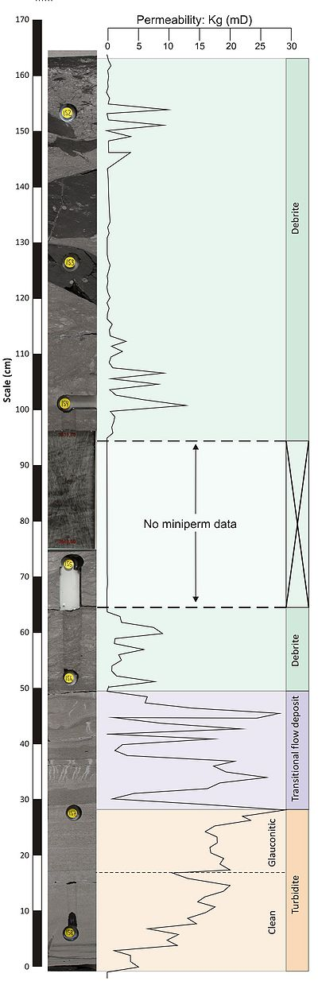
Vøring Basin example
For details see Southern et al. (2017) Sedimentology

Slide 34
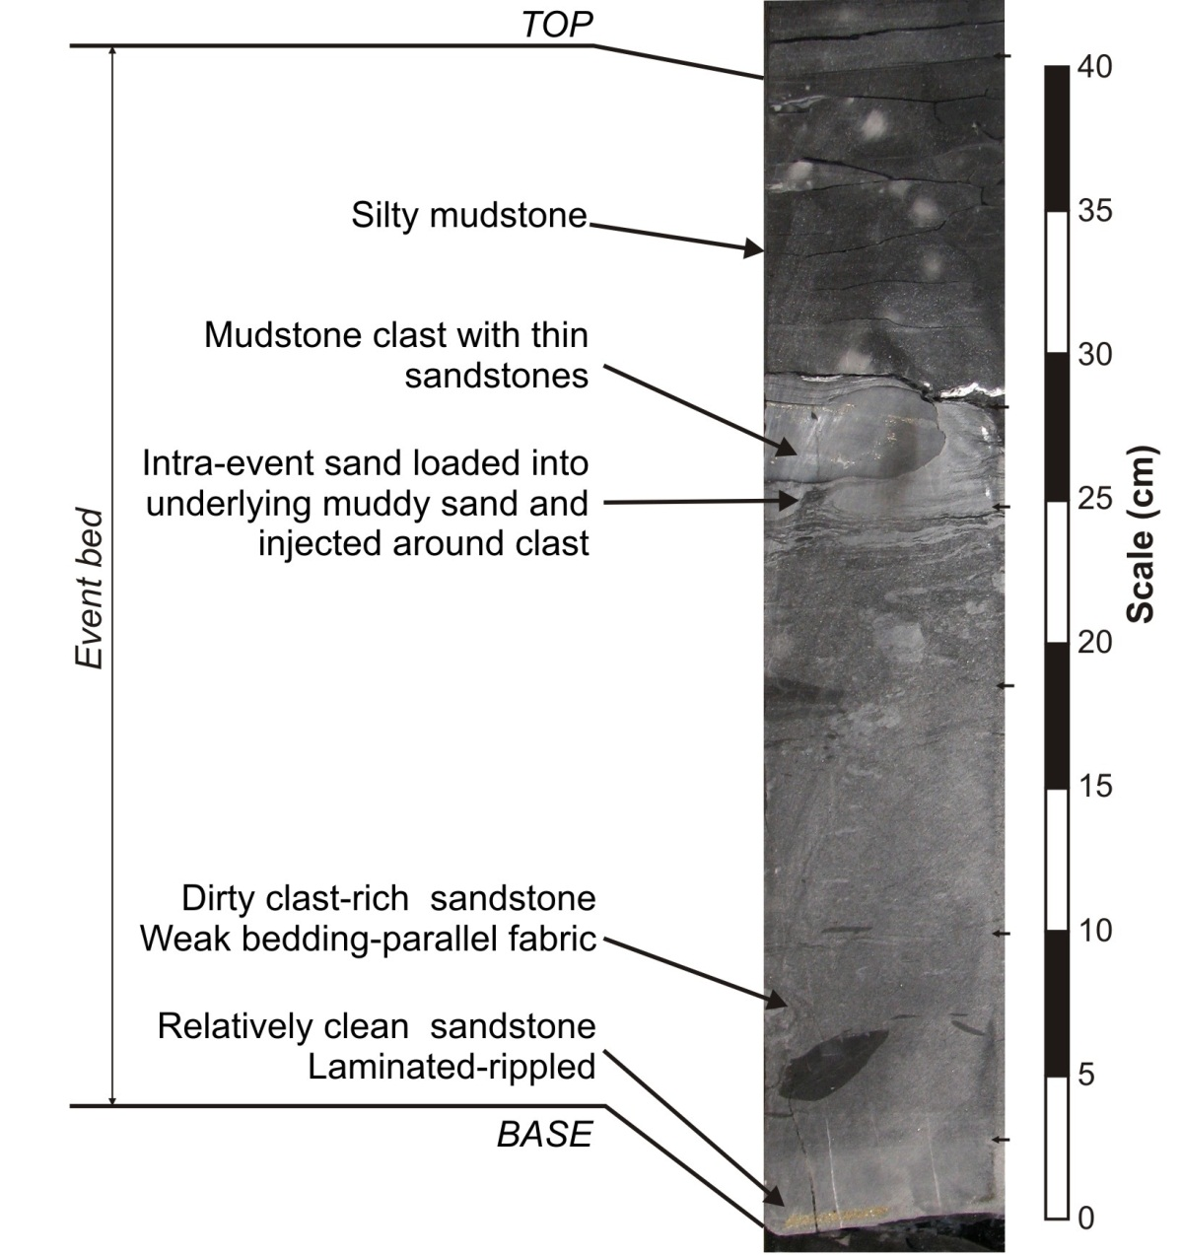
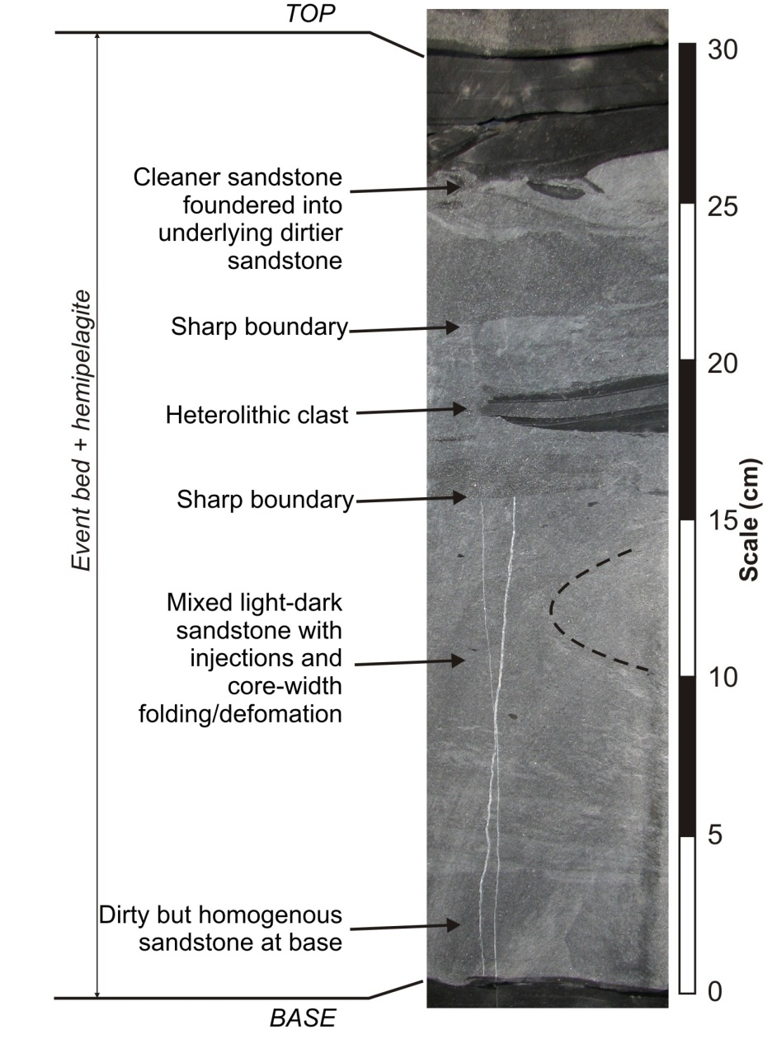
Clare core examples: ‘hybrid event bed’

Slide 35
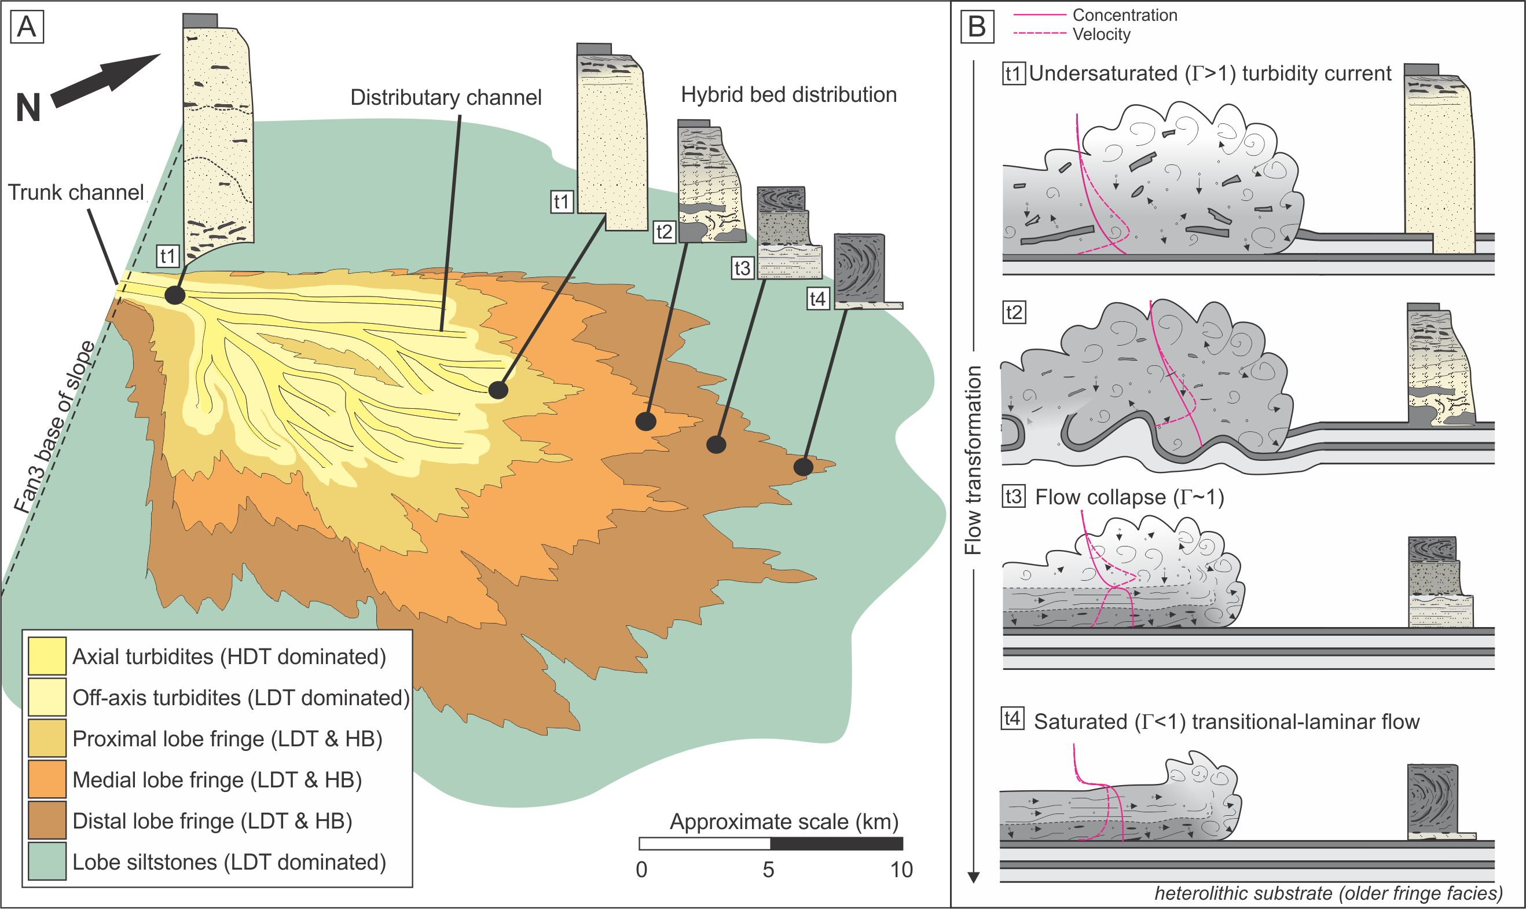
Hybrid beds in deep-marine lobes
<number> -
Classification: Internal 2011-09-03
For details see Kane et al. (2017) Sedimentology. – Paper is on Bb

Slide 36
Debris flows
Definition: A debris flow is a high concentration (typically >40%) mixture of fluid and sediment which flows downslope due to gravity. Particles are supported in the flow by the sediment and pore pressure in the flow.
Flows have a dominantly non-Newtonian rheology
Particles are supported by the flow matrix strength and pore fluid pressure which creates a buoyancy force
Deposit character is directly linked to the flow content. Flows freeze ‘en-masse’ and the deposit represents what the flow was at that time.
The deposits of debris flows are termed Debrites.

Slide 37
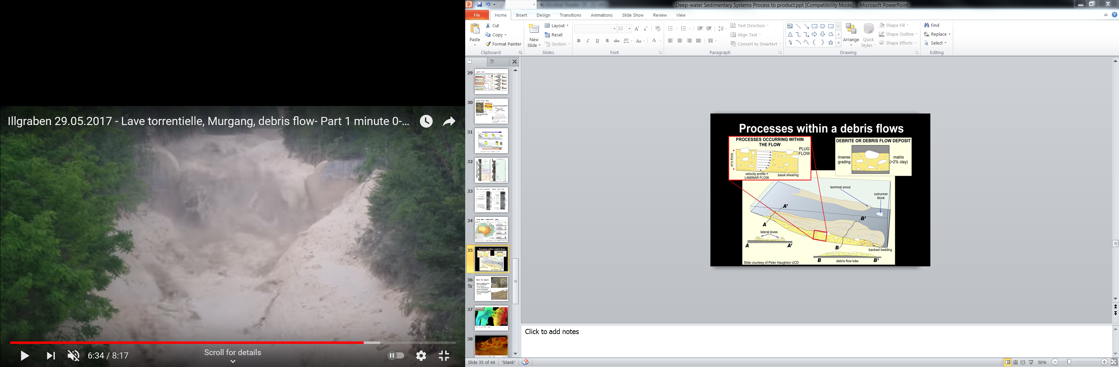
Debris flows
<number> -
Classification: Internal 2011-09-03

Slide 38
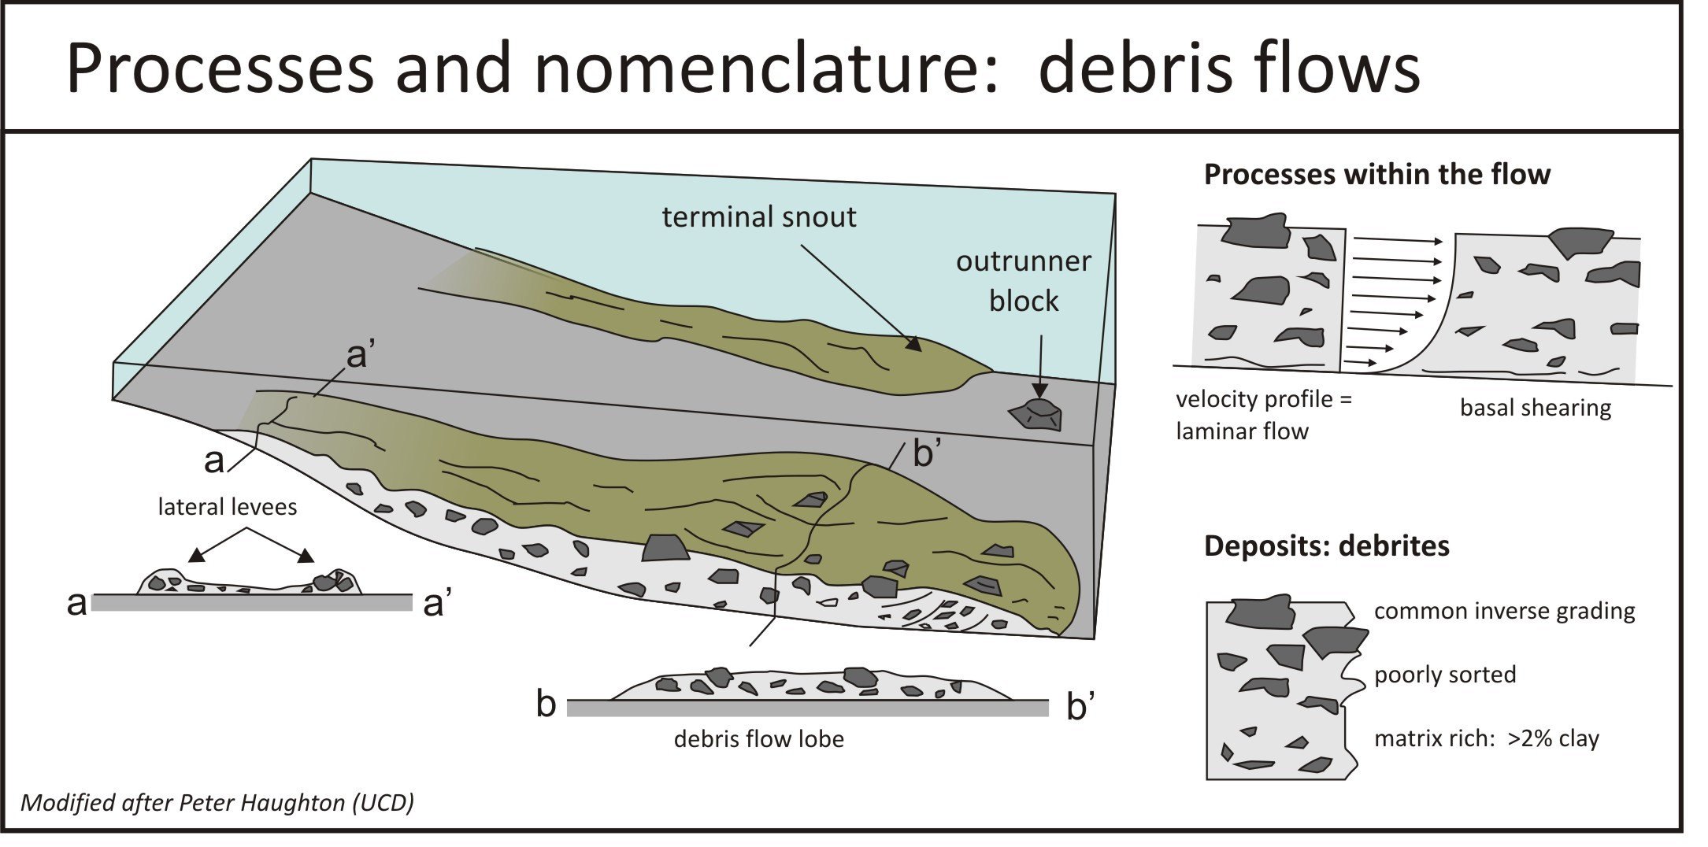

Slide 39
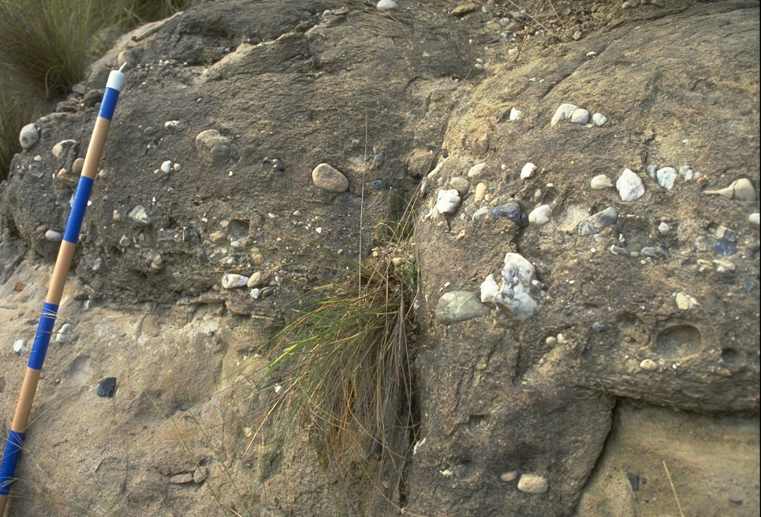
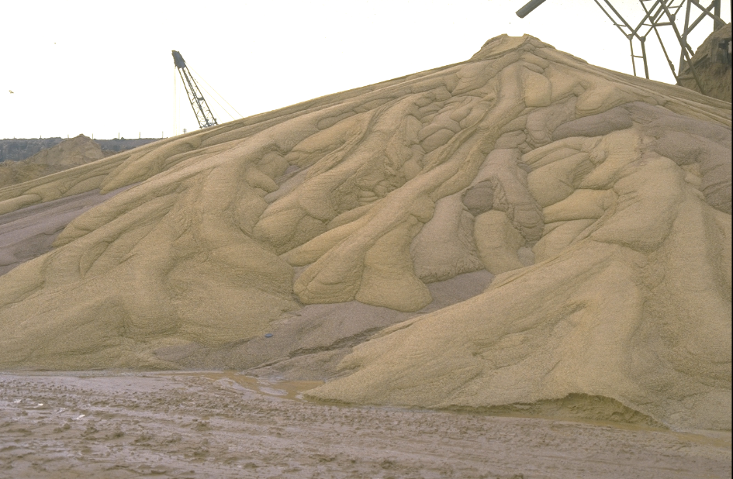
Debris flow deposits
Chaotic mixtures of different grain types and sizes
Poorly sorted or…?
Inverse grading may occur
Clasts are disorganized
Occur frequently within canyons or channels in deep-water settings

Slide 40
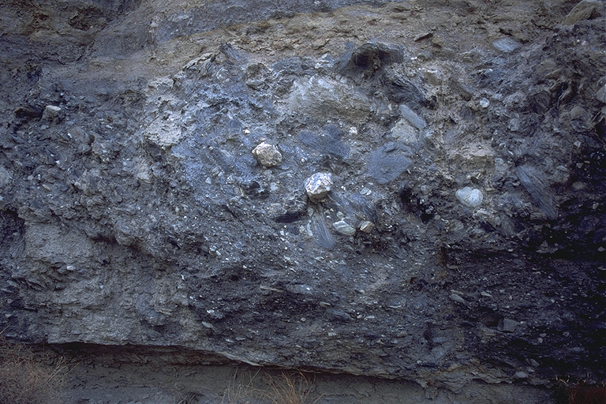
Debris-Flow Deposits (debrites)

Slide 41
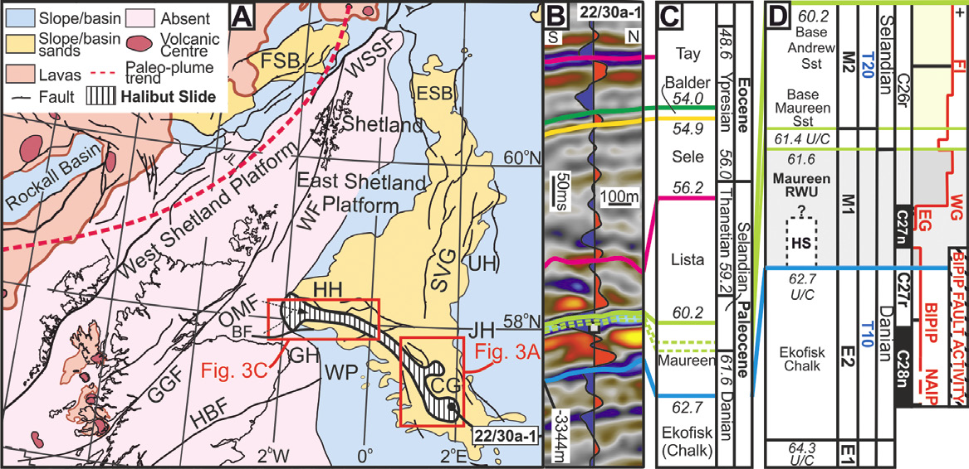
The Halibut Slide
Soutter et al. 2018.

Slide 42
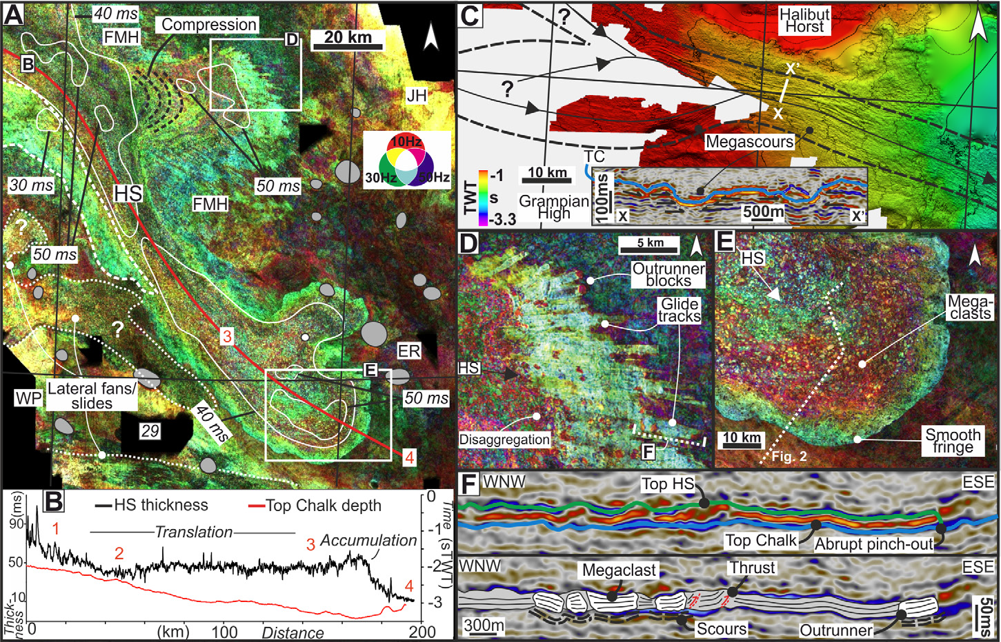
Soutter et al. 2018.

Slide 43

Debris flow fan and channels (Indonesia)

Slide 44

Debrites in core
Often difficult to discern from bioturbated textures and local remobilisation and/or injection
Large clasts in debrites difficult to distinguish from laterally persistent mudstones

Slide 45

Mudstones: All hemipelagic? What is their significance (barriers/seals/impersistent)?
Hemipelagite (condensed section)
Hemipelagite
Turbidite
Clare UCD-03
Gro 2 (Vøring)
Clare UCD-03
Clast

Slide 46

Slides and Slumps
Ross Slide, Eire
Dominated by intact, but rotated bedding (contrasts debris flows)
Occur mainly on slopes, but also front- and backsides of levees as a result of oversteepening or flow undercutting
May be difficult to recognize in core
Distance travelled may be difficult to ascertain
In subsurface and seafloor often termed ‘mass transport deposits’ or MTDs. Infers a range of processes.
El Gordo megabed, Tabernas Basin, Spain
‘slide’ from Jeff Peakell

Slide 47

<number> -
Classification: Internal 2011-09-03

Slide 48

Slope failure
<number> -
Classification: Internal 2011-09-03

Slide 49


Slide 50

Slides and Slumps

Slide 51

Taranaki Basin, NZ. Nwoko et al. 2020
<number> -
Classification: Internal 2011-09-03

Slide 52

Subamarine landslide deposits

Slide 53

Nwoko et al. 2020

Slide 54

Thermohaline currents (temperature and salinty driven flows).
<number> -
Classification: Internal 2011-09-03

Slide 55

https://www.royalholloway.ac.uk/media/11564/drift-b.jpg
<number> -
Classification: Internal 2011-09-03

Slide 56

Plastic input to the Tyrrhenian Sea
Classification: Internal 2011-09-03
Kane et al. (2020) Science.

Slide 57


Slide 58
SUMMARY:
Physical processes of sediment transport in deep water
Six classes ranging from creep of consolidated material to fall of completely unconsolidated sediment
Increasing mobility of material and grain freedom from creep to fall
Sediment gravity flows are most important for moving coarse sediment to deep water environments
Most flow types are transitional with others, as they incorporate fluid, and entrain or deposit sediment.
Other flows: thermohaline flows, deep-tidal flows in canyons

